Slide 1

RESPIRATORY SYSTEM
IN HUMAN BODY
NAME : ALLU HARINI
REG NO : 192224032
SLOT : B
CODE : BTA0185
DEPARTMENT : AI & DS

Slide 2

CONTENTS
Abstract
Objectives
Literature Review
Results and Discussion
Methodology
Data Analysis
Suggestions
Conclusion
References

Slide 3
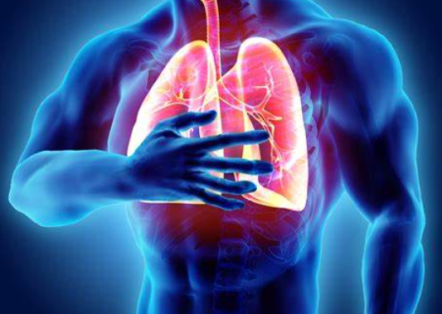
ABSTRACT
The respiratory system is the network of organs and tissues that help you breathe. It includes your airways, lungs and blood vessels. The muscles that power your lungs are also part of the respiratory system. These parts work together to move oxygen throughout the body and clean out waste gases like carbon dioxide.

Slide 4
RESPIRATORY SYSTEM PATHWAY
MOUTH/NOSE
TRACHEA
BRONCHI
RED BLOOD CELLS
ALVEOLI
BRONCHIOLES

Slide 5
OBJECTIVES
To State the overall functions of the respiratory system.
To describe the importance of the respiratory system as a homeostatic mechanism.
To describe secondary functions of the respiratory system.
To limit the organs of the respiratory system.
To describe the structural characteristics of the respiratory mucosa.
The different measurements of lung capacity and breathing.
The composition of inhaled and exhaled air

Slide 6
LITERATURE REVIEW
In 2011 , Lynda Facchiano gave a review on Breathing retraining as a self management strategy “She critically appraise and synthesize the literature on breathing retraining as a self-management strategy for individuals with chronic obstructive pulmonary disease (COPD) guided by Rosswurm and Larrabee's evidence-based practice model . In the end she concluded that An exhaustive review of the literature revealed evidence that regularly practiced pursed lip breathing is an effective self-management strategy for individuals with COPD to improve their dyspnea". [1]
In 2020 , Kate Emerich Gordan gave a review on Role of the pelvic floor in respiration “To conduct an interdisciplinary literature review on the function of the pelvic floor musculature during respiration and its role in phonation, particularly singing. The physical medicine literature includes the pelvic floor musculature as having an important role in respiration, as a key player in the generation of intra-abdominal pressure, and as a primary expiratory muscle." [2]
In 2011 , Joseph L Mathew gave a review on Acute respiratory infection and pneumonia in india “He identified , synthesize and summarize current evidence to guide scaling up of management of childhood acute respiratory infection/pneumonia in India, and identify existing knowledge gaps and he conclude that The systematic review summarizes current evidence on childhood ARI and pneumonia management and provides evidence to inform child health programs in India." [3]

Slide 7
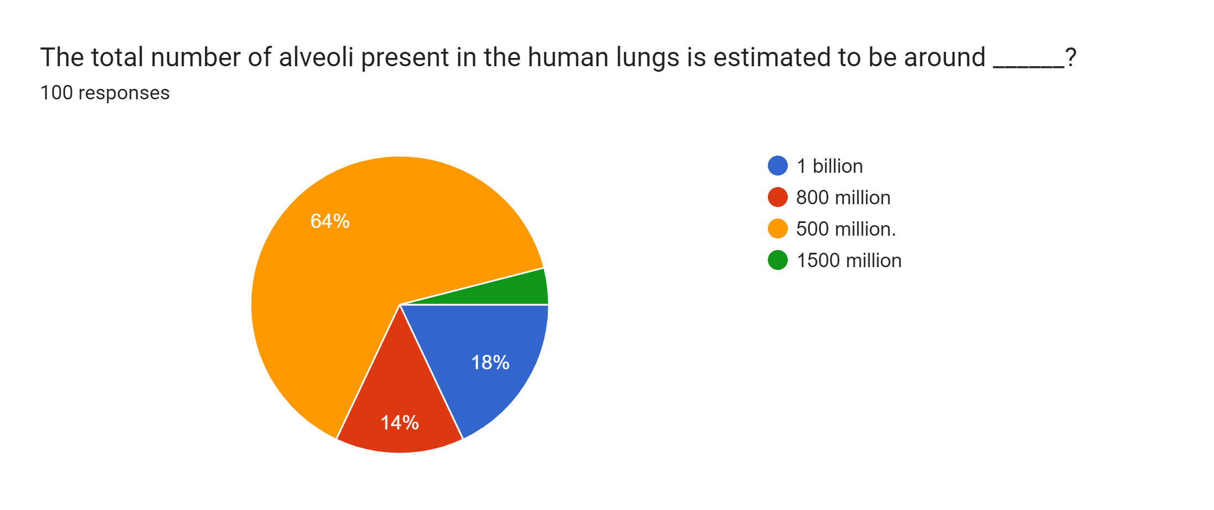
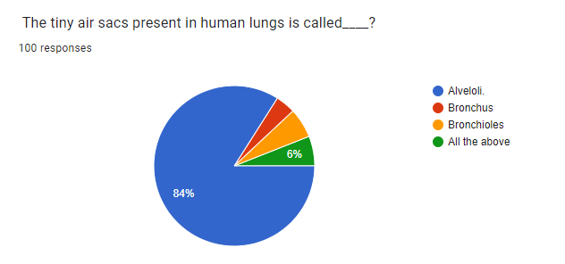
QUESTIONS

Slide 8
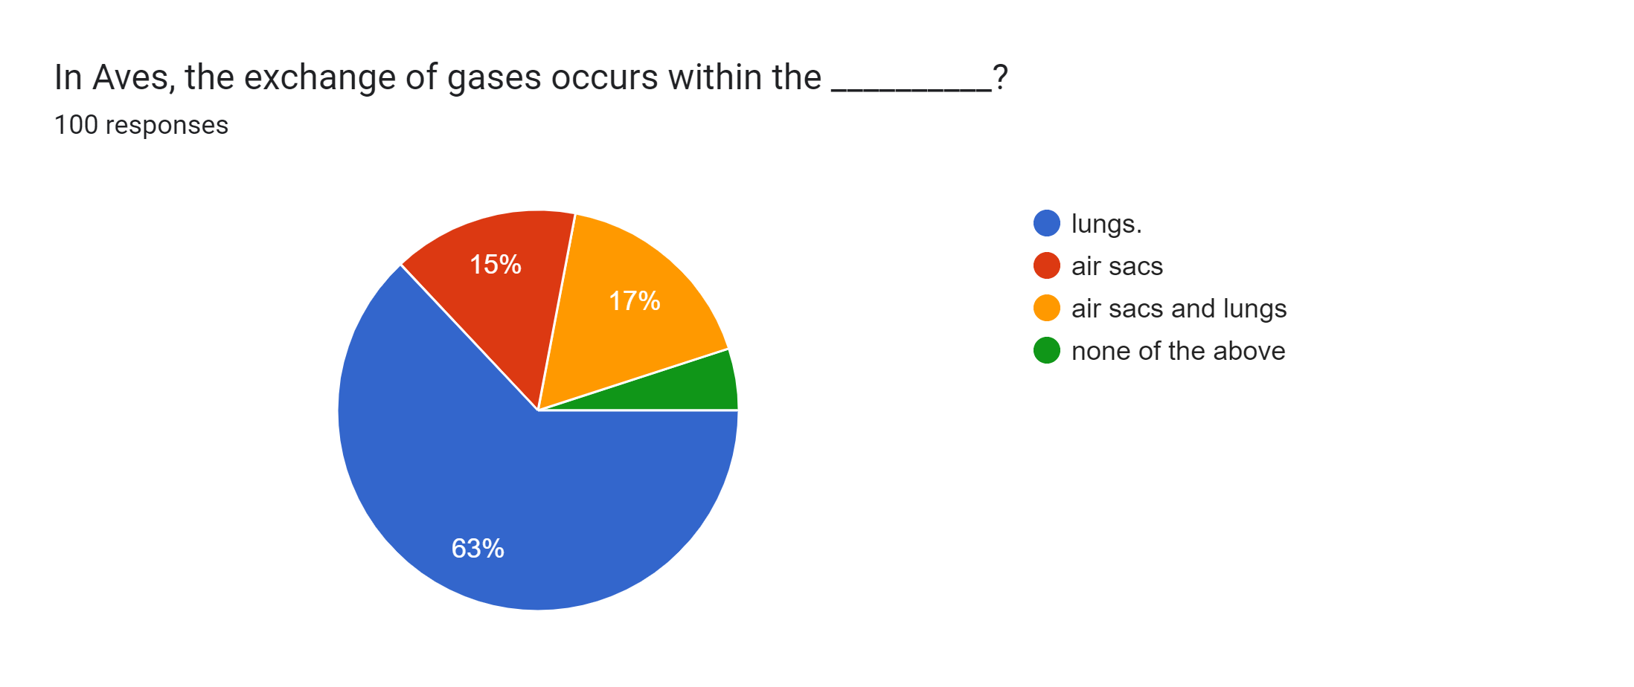
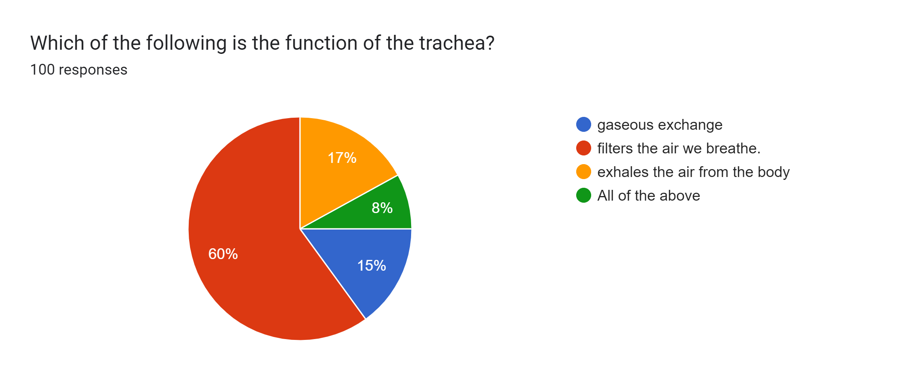
QUESTIONS

Slide 9
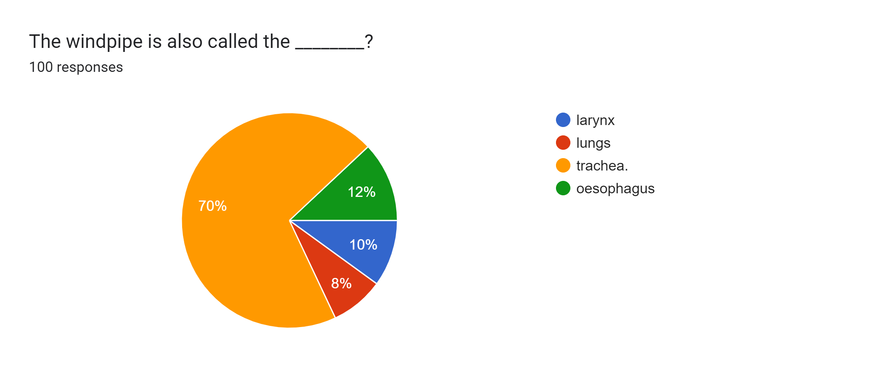
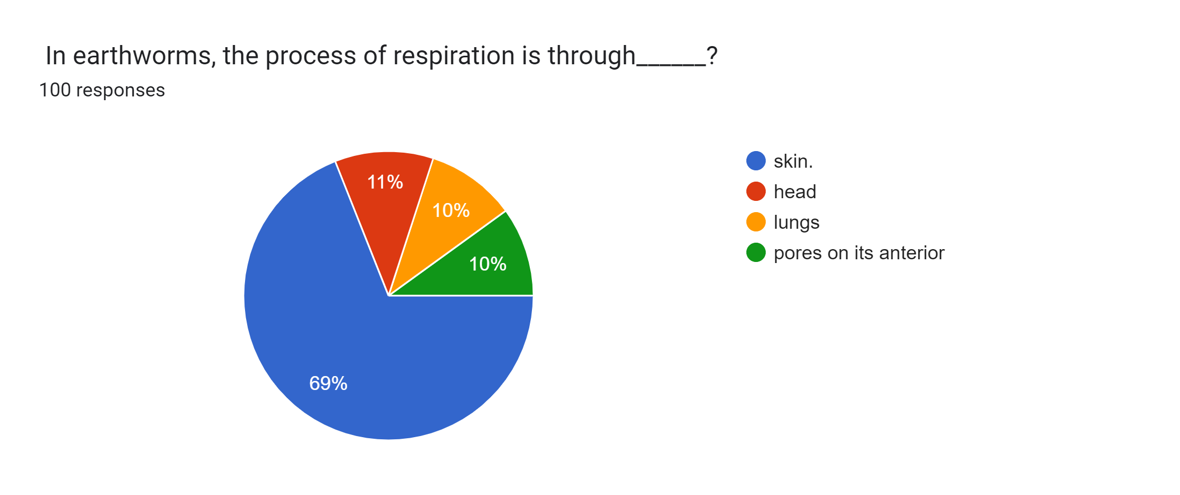
QUESTIONS

Slide 10
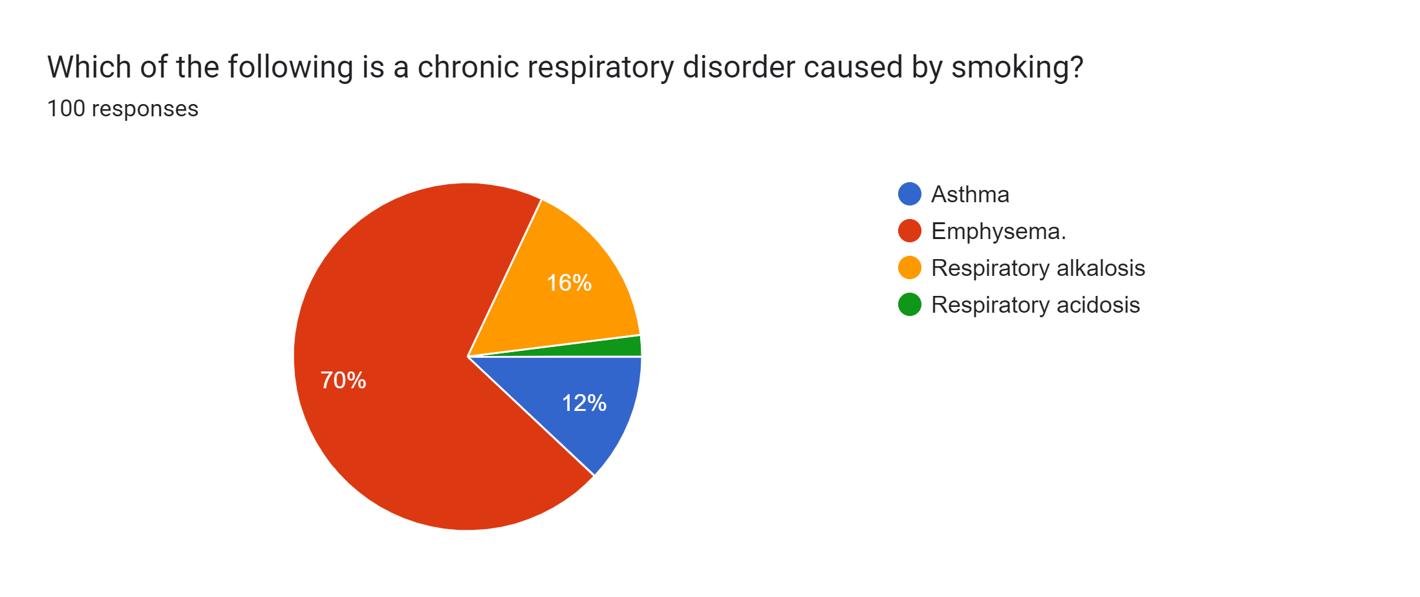
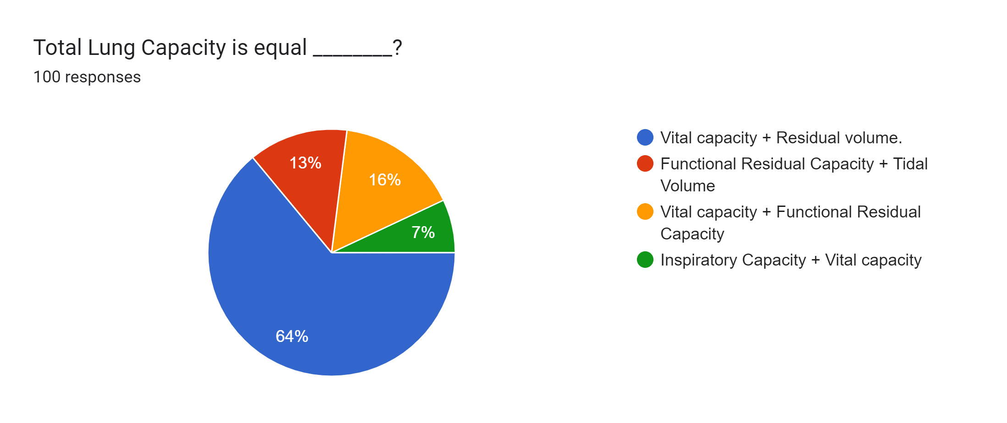
QUESTIONS

Slide 11
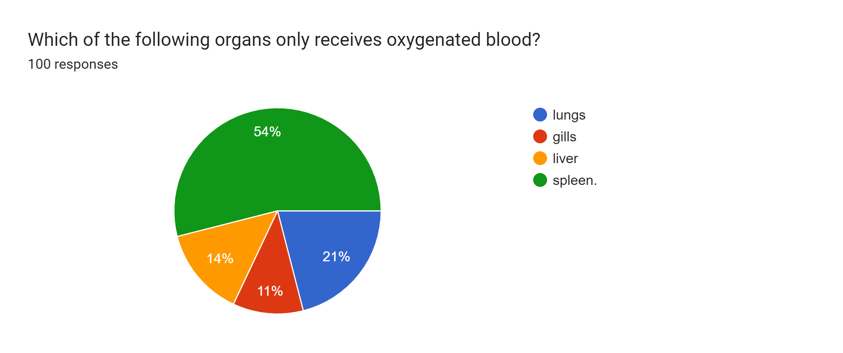
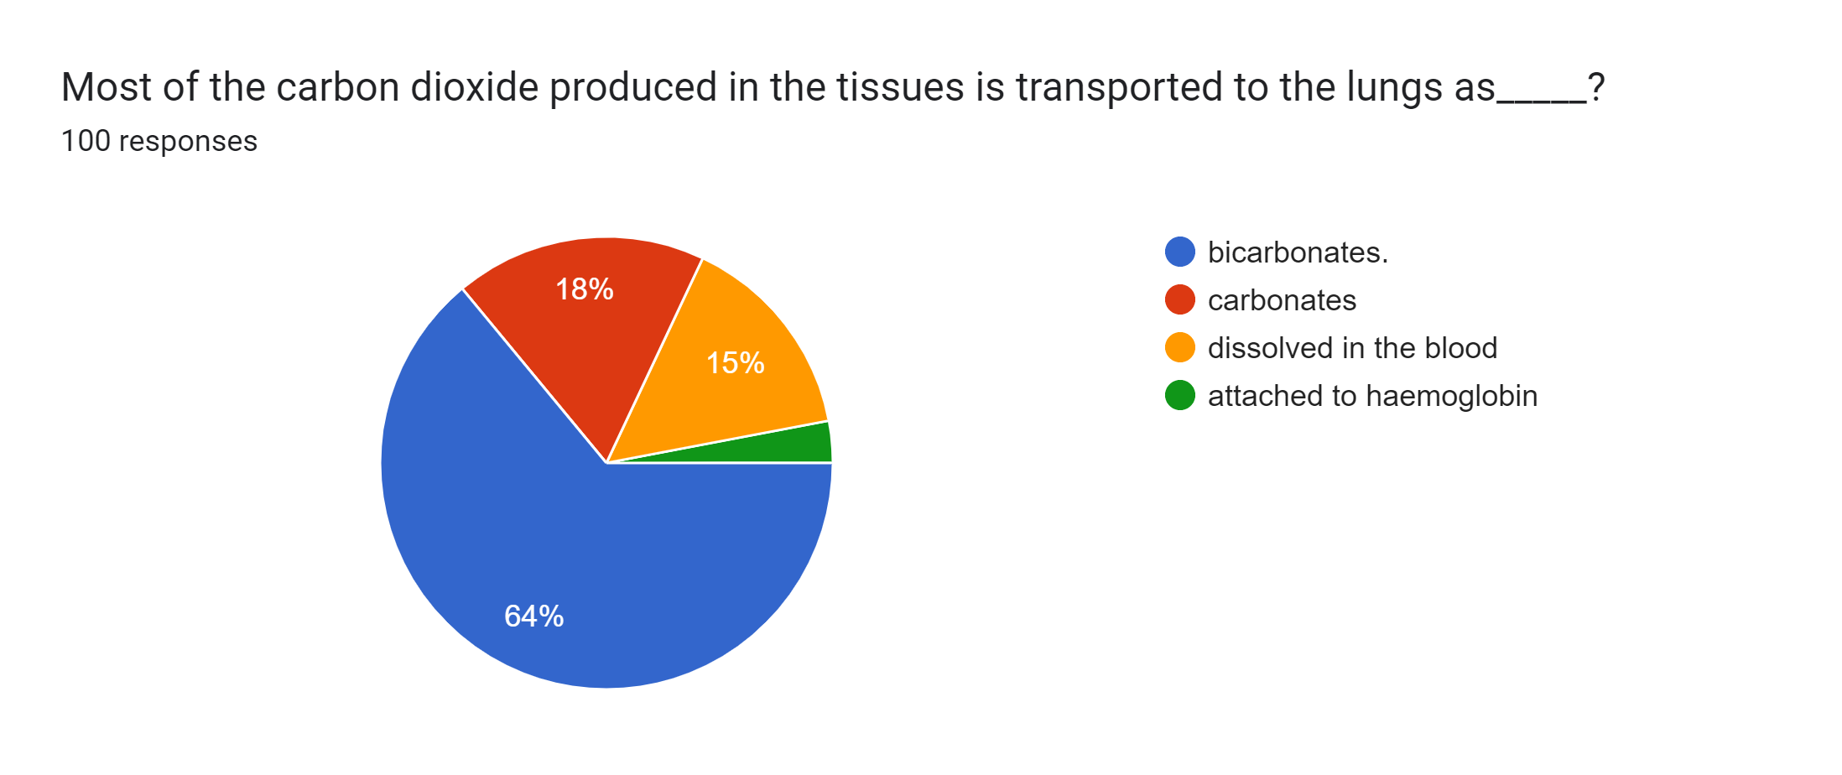
QUESTIONS

Slide 12
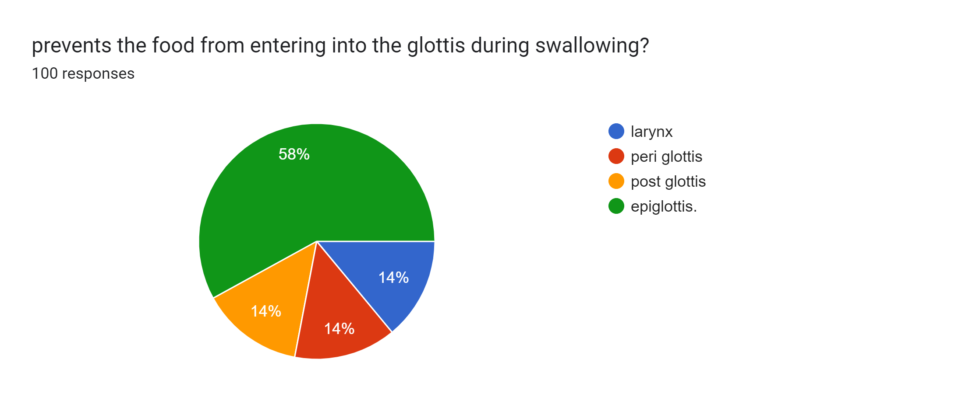
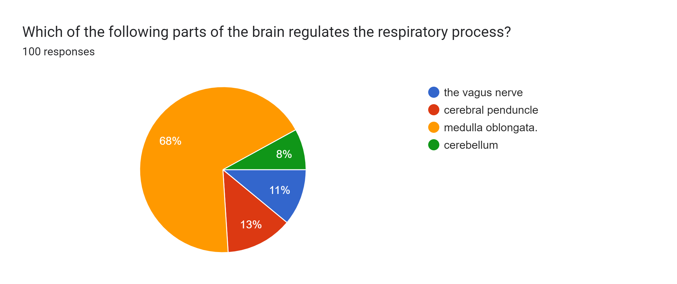
QUESTIONS

Slide 13

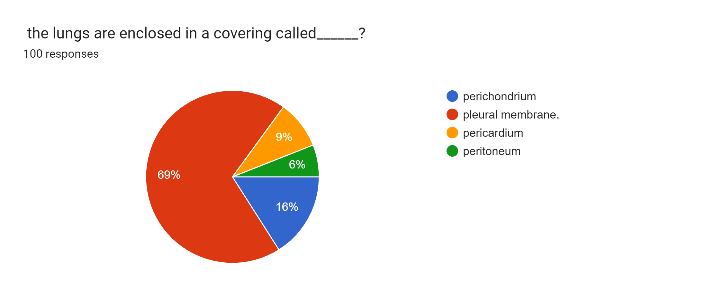
QUESTIONS

Slide 14
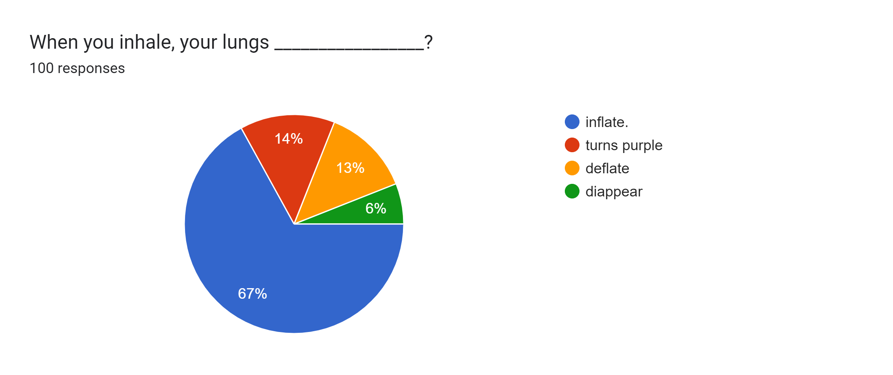
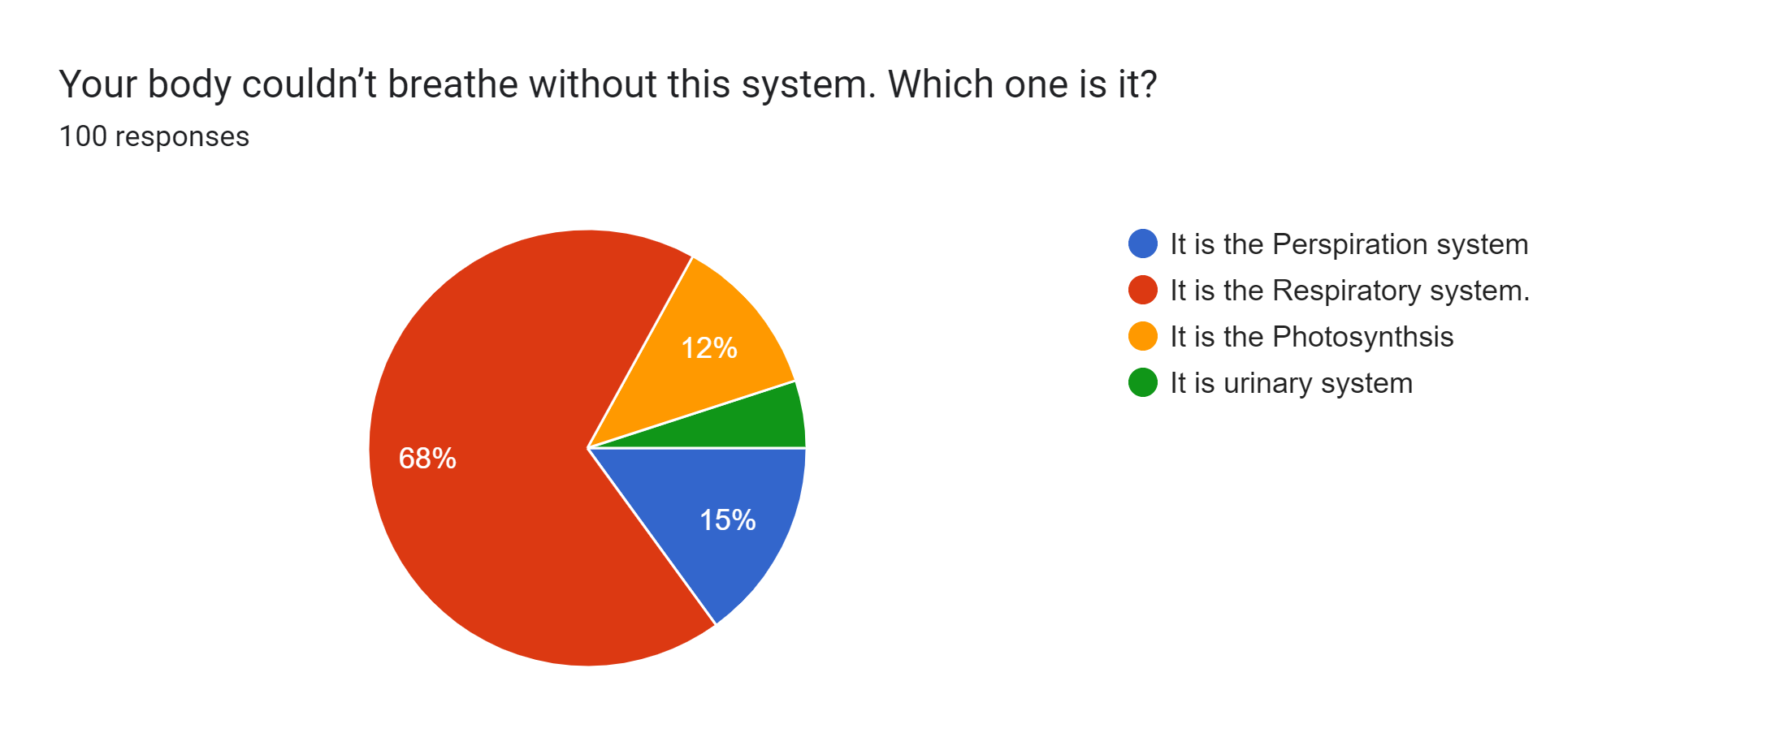
QUESTIONS

Slide 15

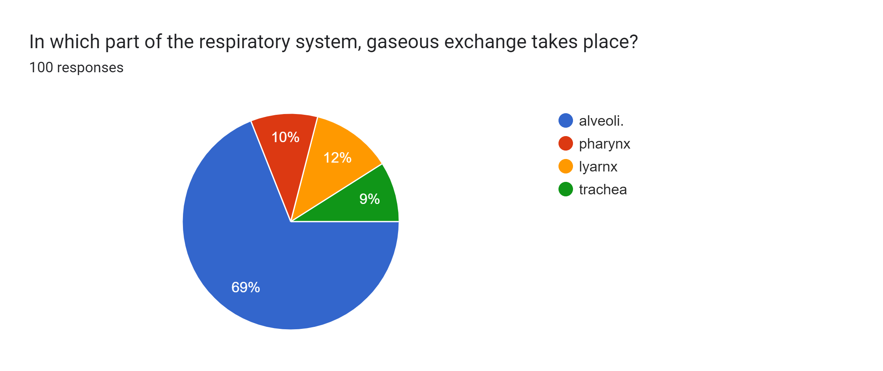
QUESTIONS

Slide 16
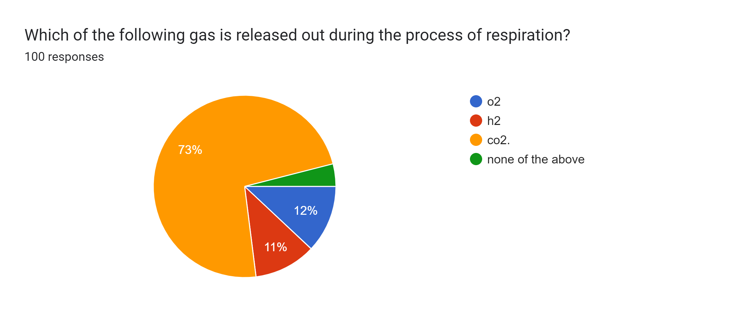
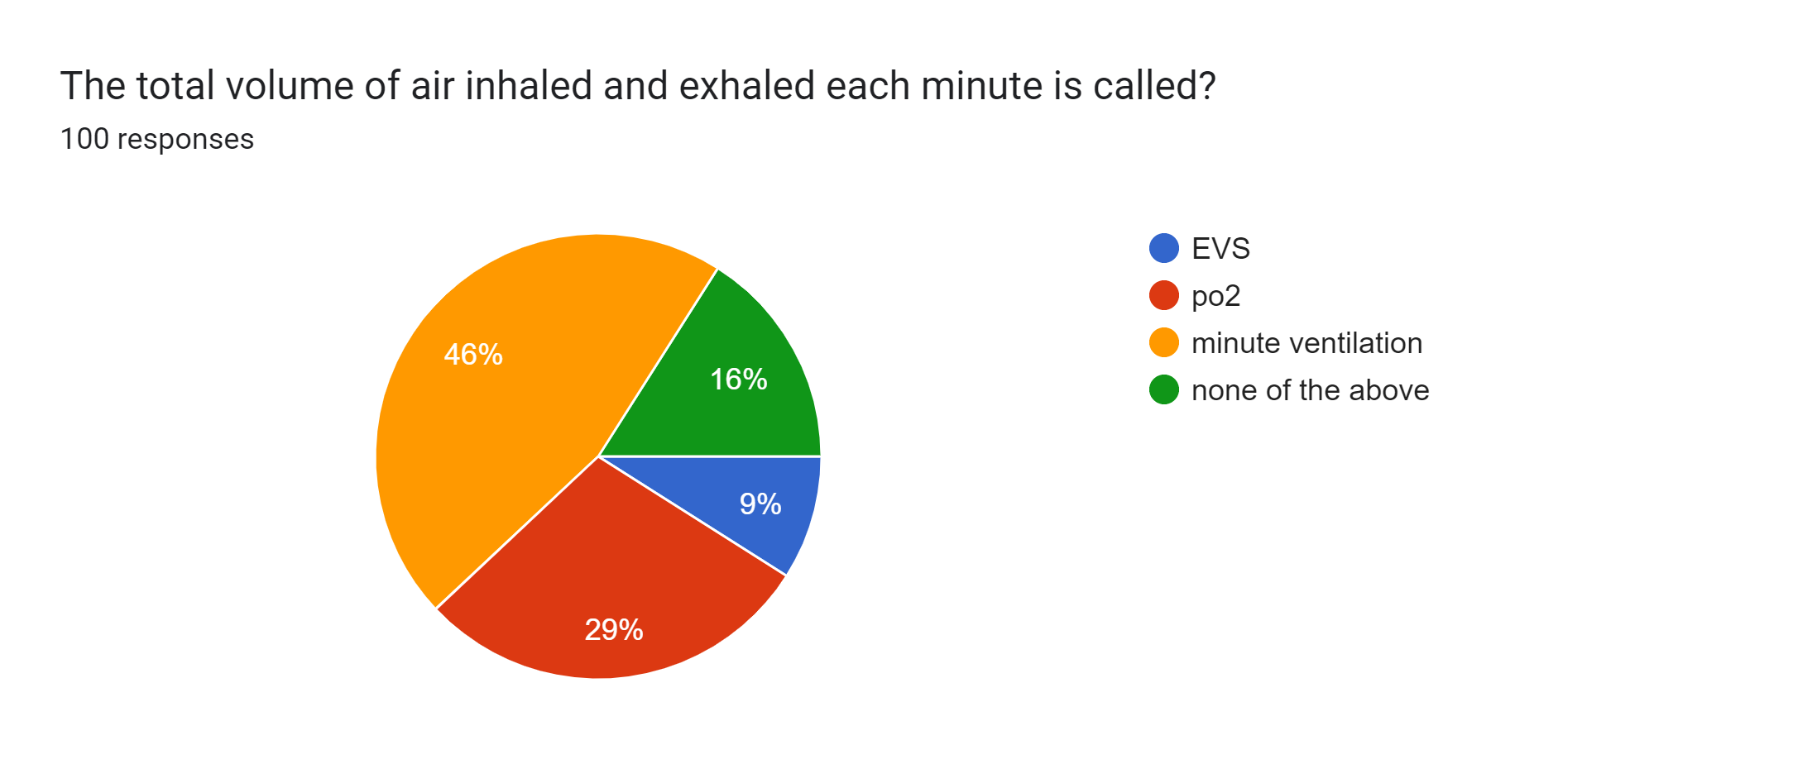
QUESTIONS

Slide 17
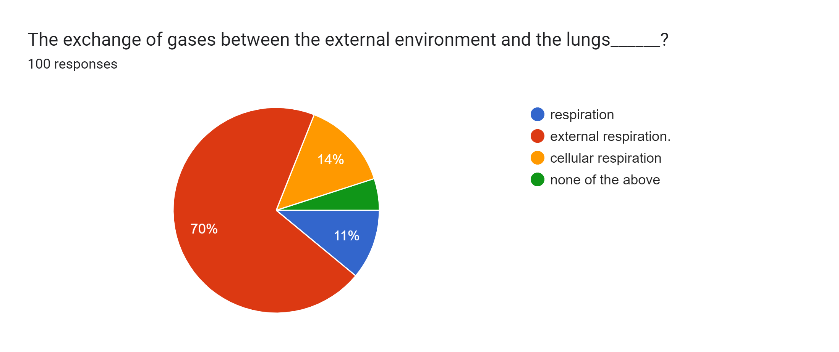
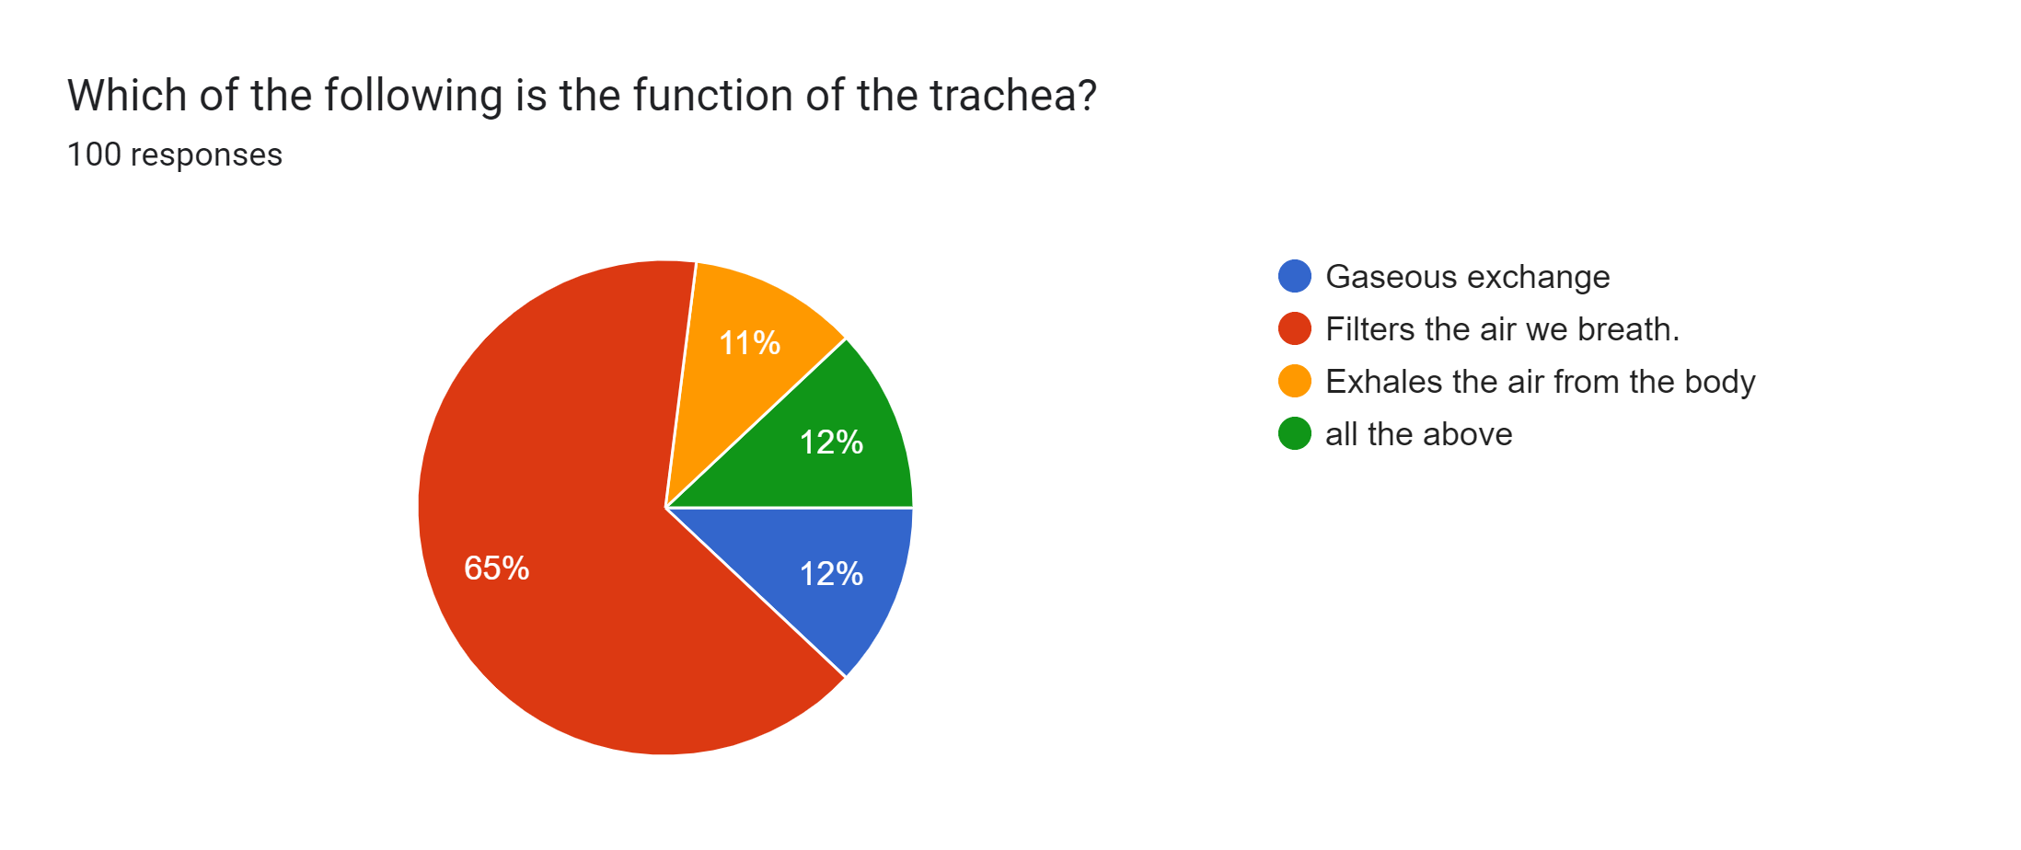
QUESTIONS

Slide 18
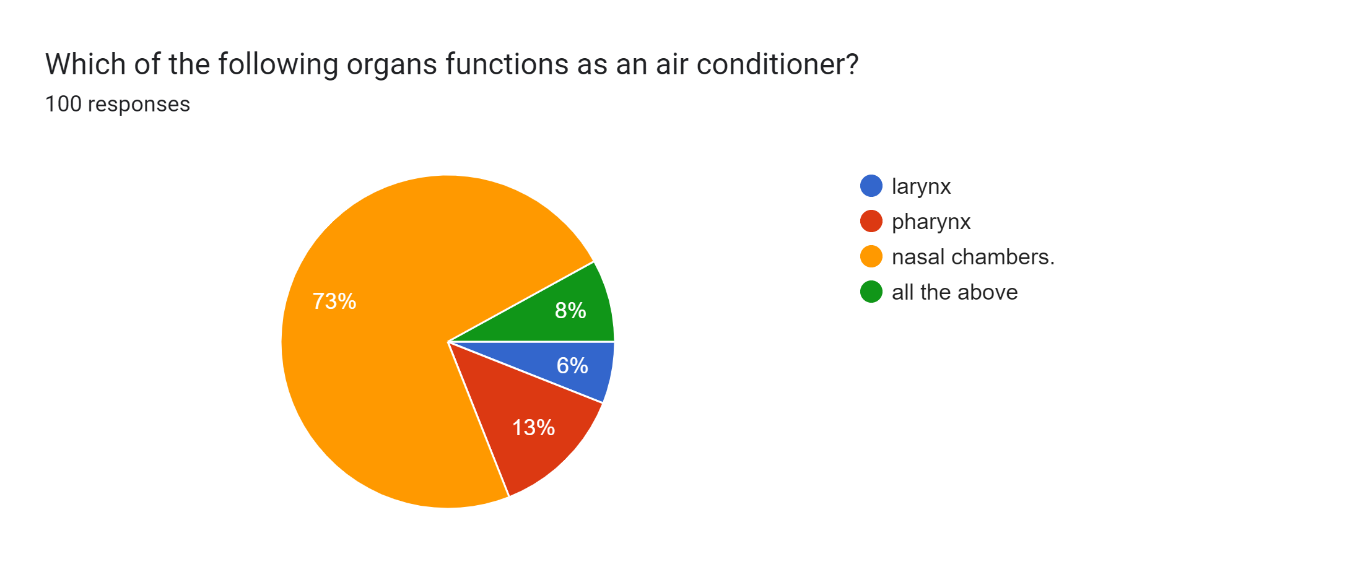
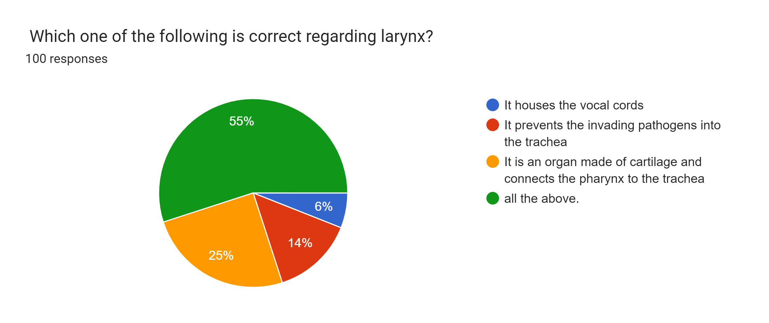
QUESTIONS

Slide 19
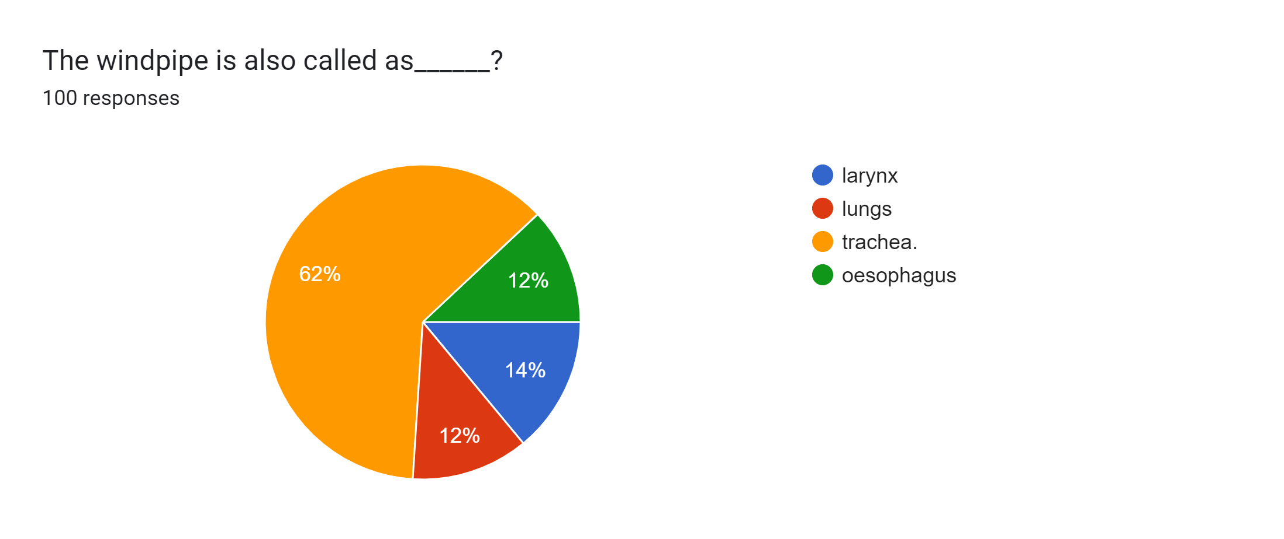
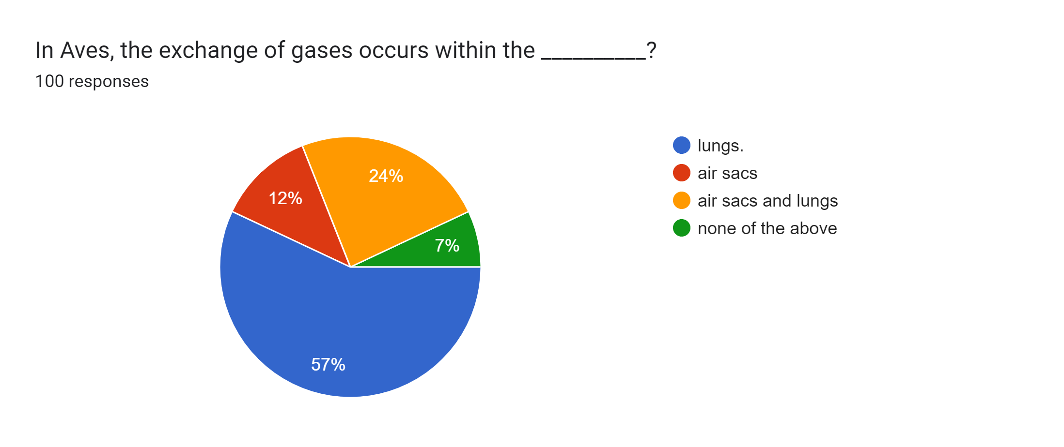
QUESTIONS

Slide 20
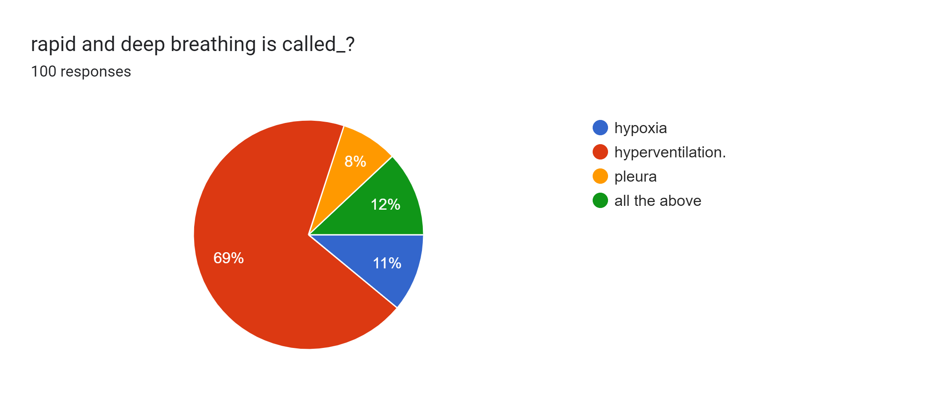

QUESTIONS

Slide 21
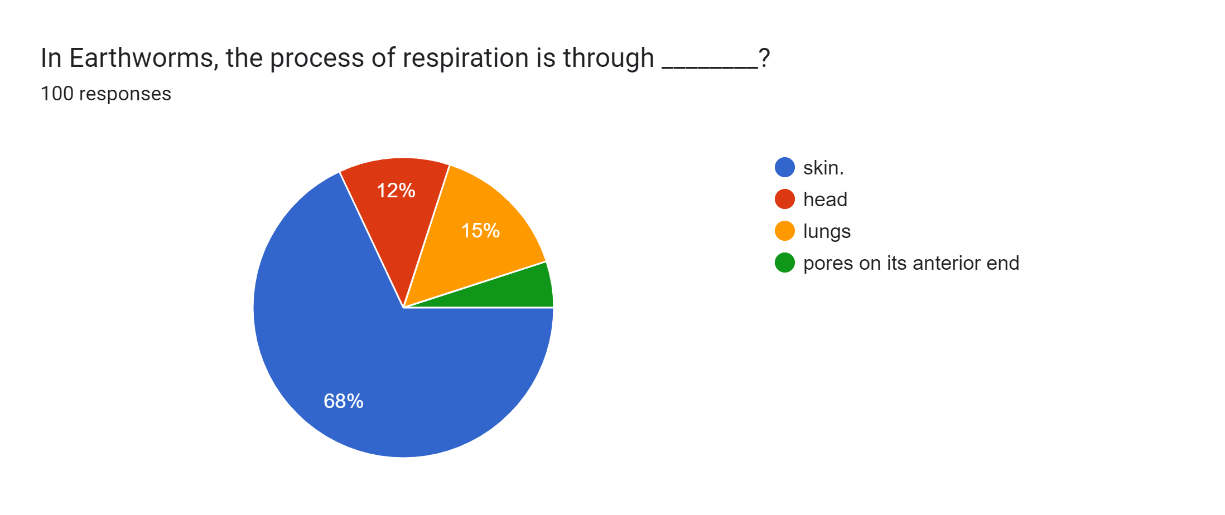
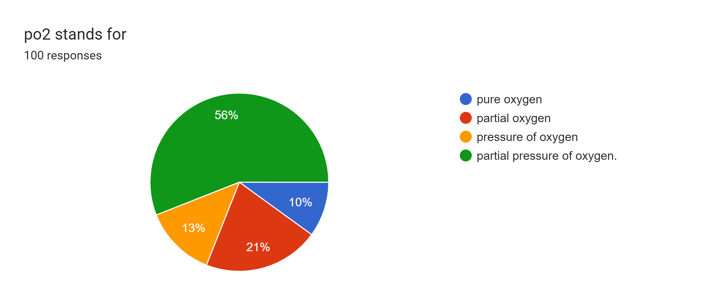
QUESTIONS

Slide 22
METHODOLOGY
This research includes qualitative and quantitative analysis on how respiratory system works . It also includes personal opinion of various individuals . This raw data is collected and imported to represent our research basis.
For the quantitative analysis we created a questionnaire based on low-level respiratory studies. This questionnaire was distributed to individuals to know their opinion. Apart from the survey, we referred various papers and thesis of scholars from Google Scholar .The extracted articles have been inserted in the literature review part of this paper.
We have prepared the overall project report with the assistance of Microsoft Word, Excel Sheets and Google Forms. The results have been summarized and uploaded in the data collection.

Slide 23
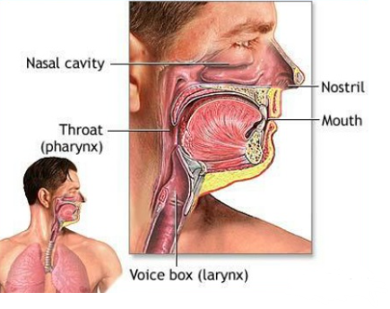
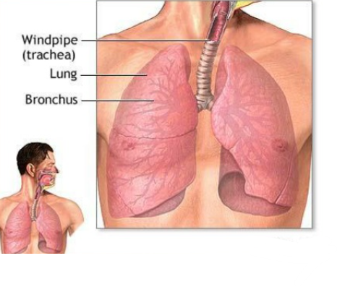
PARTS
The respiratory system is divided into two parts :​
Upper respiratory tract Lower respiratory tract​
​

Slide 24
Functions Of Respiratory System
Primary Functions:
The respiratory system provides oxygen for metabolism in the tissues.
The respiratory system removes carbon dioxide, the waste product of metabolism
Secondary Functions:
The respiratory system facilities sense of smell.
The respiratory system maintains acid-base balance.
The respiratory system maintains body water levels.
The respiratory system maintains heat balance.

Slide 25
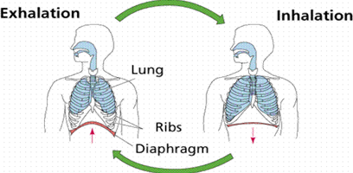
BREATHING
Breathing consists of two cyclic phases:
Inhalation , also called inspiration – draws gases into the lungs
Exhalation , also called expiration – forces gases out of the lungs

Slide 26
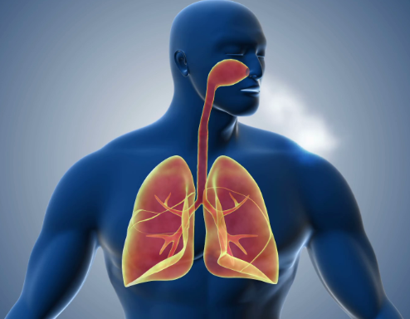
Upper respiratory tract contains:
Nose or Nostrils
Nasal Cavity
Mouth
Pharynx
Larynx(voice box)
Lower respiratory tract contains:
Trachea(wind pipe)
Lungs
Bronchioles
Alveoli

Slide 27
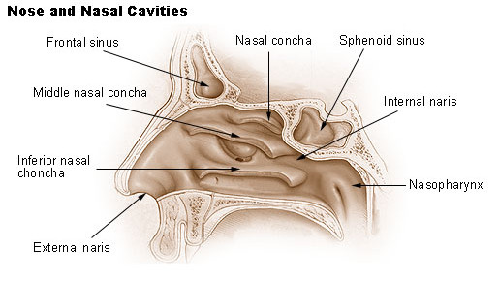
NOSE AND NASAL CAVITY
Also called external Nostrils(nares)
Divided into two halves by the nasal septum.
Contains the paranasal sinuses where air is warmed.
Contains cillia which is responsible for filtering out foreign bodies.
Nasal cavity is the space inside the nose. The nasal cavity lies above the bone that forms the roof of the mouth and curves down at the back to join the throat. It is divided into two sections called nasal passages. Air moves through these passages during breathing

Slide 28
PHARYNX
Common space used by both the respiratory and digestive systems.
Commonly called the throat.
Originates posterior to the nasal and oral cavities and extends inferiorly near the level of the bifurcation of the larynx and esophagus.
Common pathway for both air and food.
Walls are lined by a mucosa and contain skeletal muscles that are primarily used for swallowing.
Flexible lateral walls are distensible in order to force swallowed food into the esophagus.

Slide 29
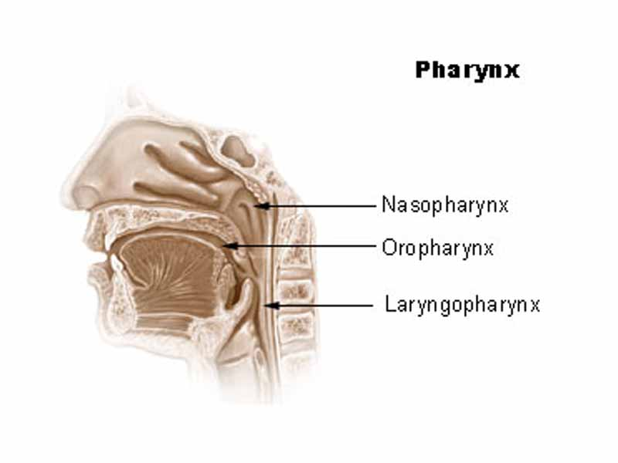
Three sections of the pharynx
Nasopharynx
The upper part of the throat behind the nose . It allows air to pass from your nose into your windpipe and eventually into your lungs.
Oropharynx
The part of the throat at the back of the mouth behind the oral cavity. It allows air to pass from your nose into your windpipe and eventually into your lungs.
Laryngopharynx
Bottom section of the pharynx where the respiratory tract divides into the esophagus and the larynx

Slide 30
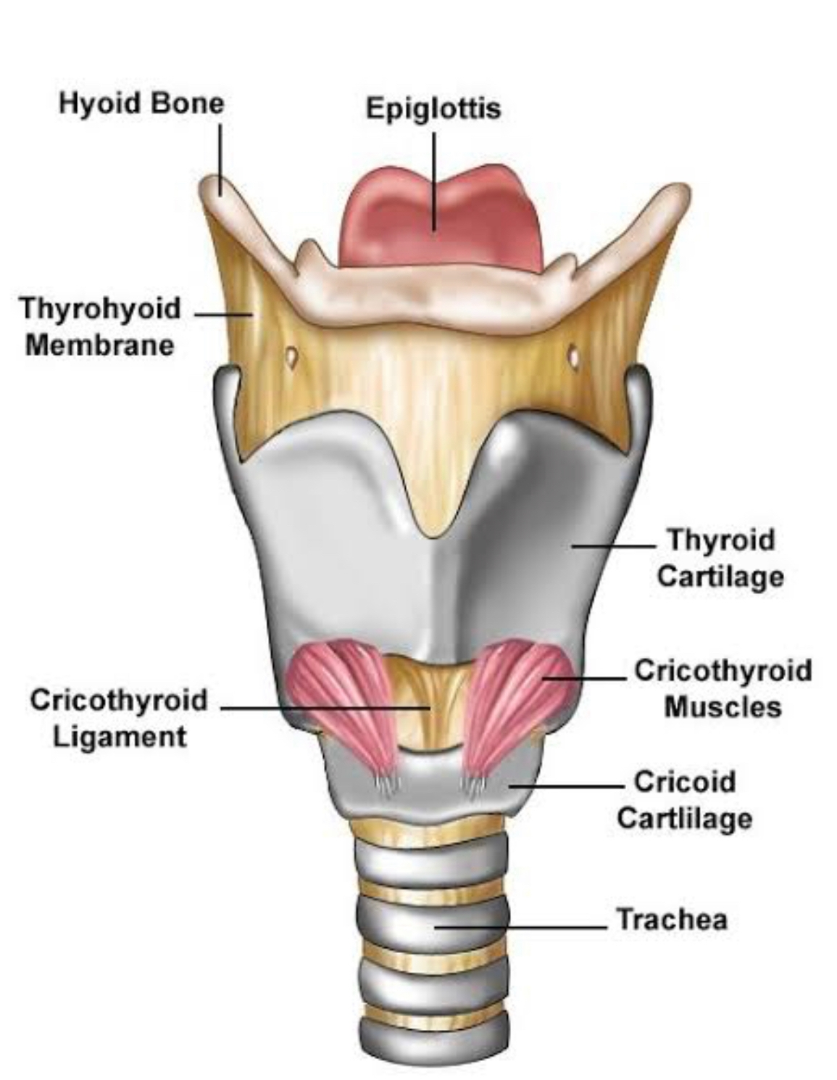
LARYNX
The main function of the larynx is sound production. That's why it is also known as Sound Box.
The larynx (voice box) is the area that connects the throat to the windpipe (trachea). Without it, we would hardly be able to sing or speak. It also keeps food and drink out of the windpipe.

Slide 31
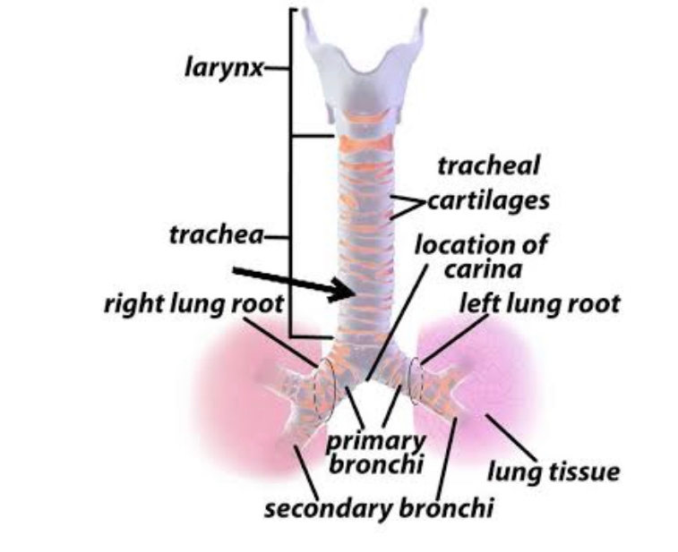
TRACHEA
The trachea or windpipe is a smooth , muscular tube leading from the larynx to the main bronchi.
The main function is to carry air in and out of your lungs.
It protects the respiratory surface form an accumulation of foreign particles.

Slide 32
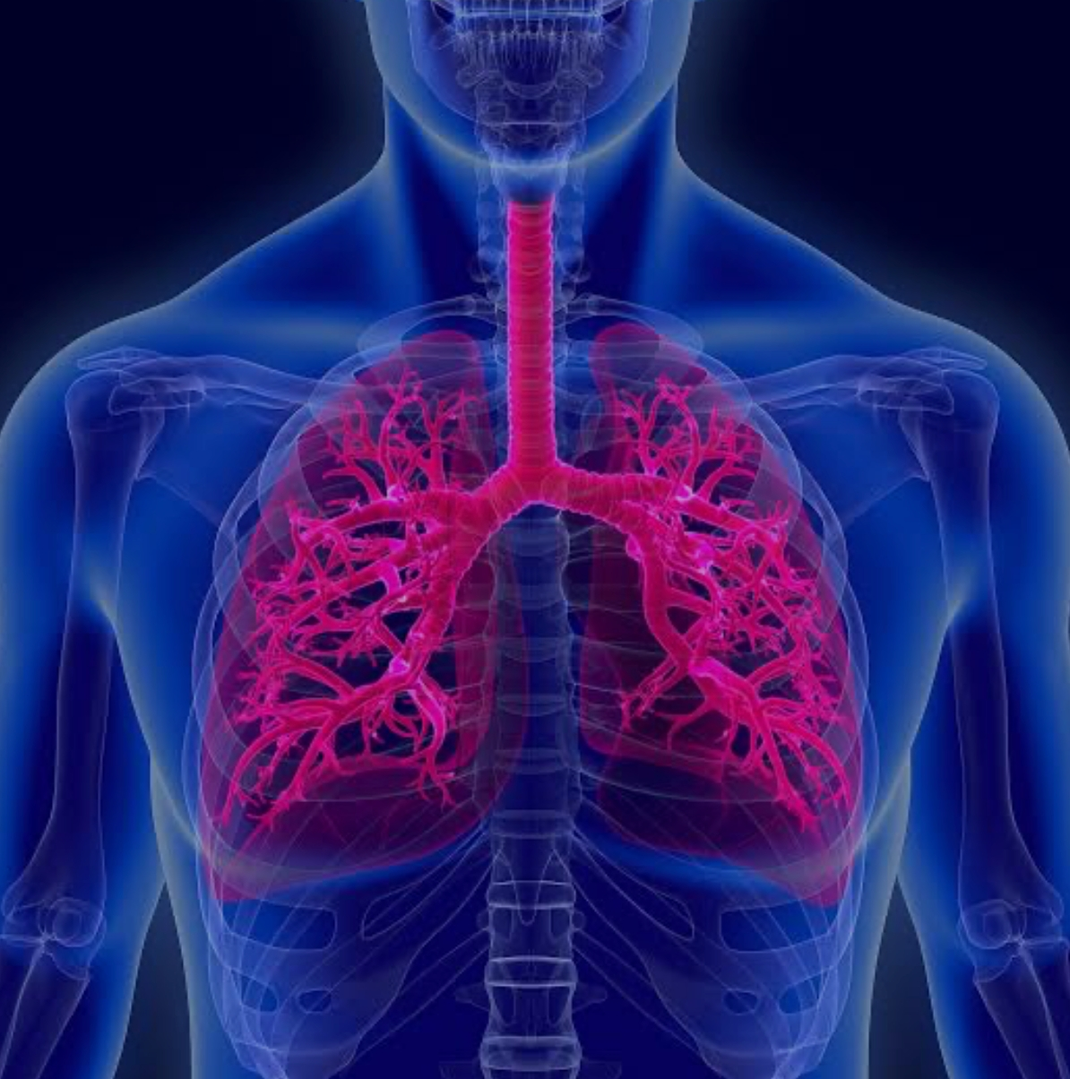
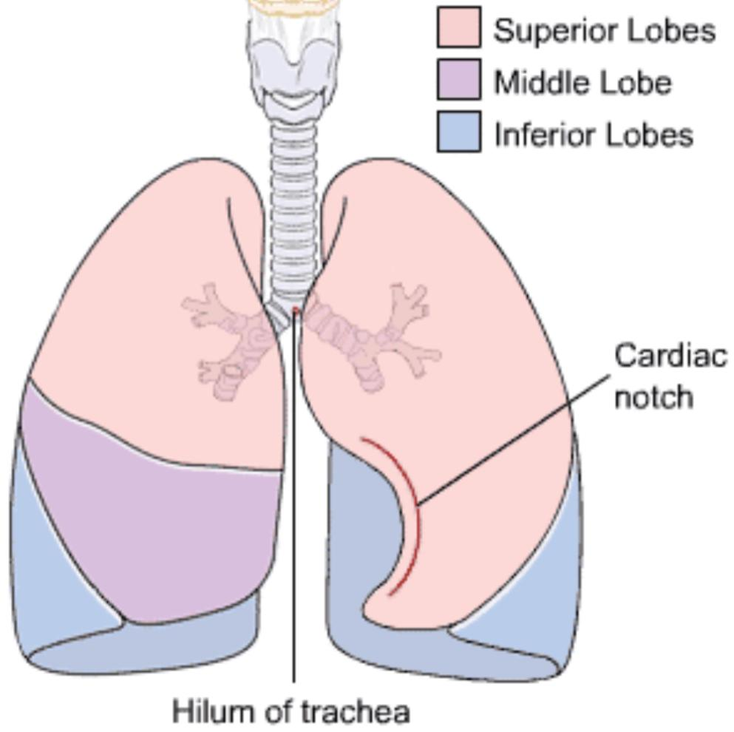
THE LUNGS
The lungs are two spongy organs located in the thorax. They consist of elastic tissue, filled with an interlacing network of tubes and sacs that carry air and blood vessels that carry blood.
Each lung is divided into lobes, the right lung into 3 lobes and the left lung into 2. The left lung has an indentation called the cardiac depression or notch. for placement of the heart.

Slide 33
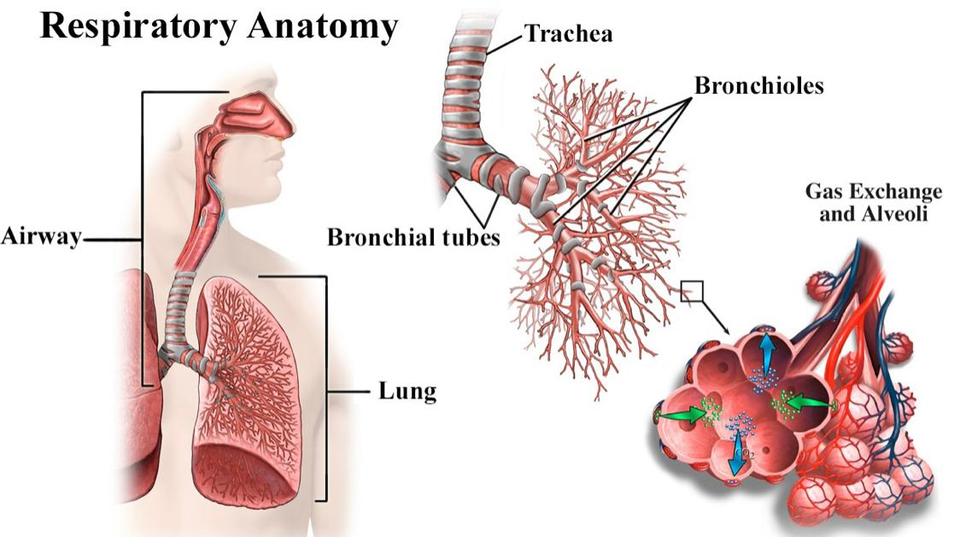
THE LUNGS
At the end of each bronchiole,are the alveoli
The lungs contain about 300 million alveoli sacs, which are the air cells where the exchange of oxygen and carbon dioxide takes place with the capillaries.

Slide 34
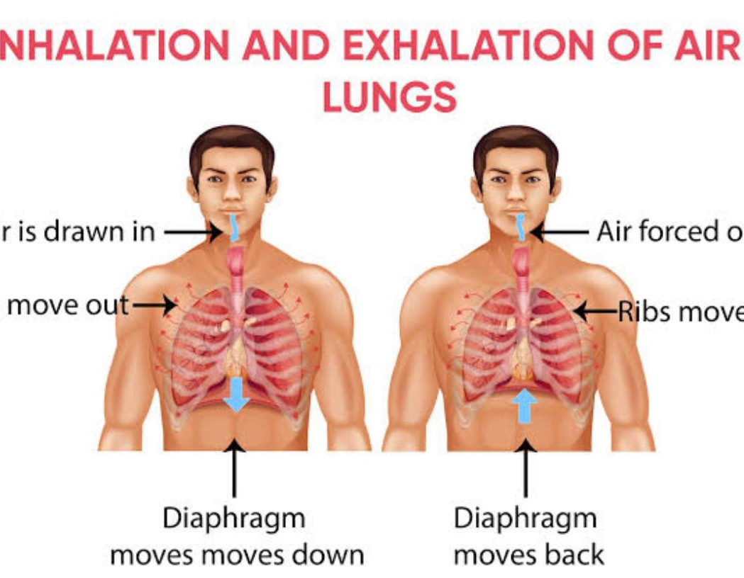
MECHANISM
When the lungs inhale, the diaphragm contracts and pulls downward. At the same time, the muscles between the ribs contract and pull upward. This increases the size of the thoracic cavity and decreases the pressure inside. As a result, air rushes in and fills the lungs.
When the lungs exhale, the diaphragm relaxes, and the volume of the thoracic cavity decreases, while the pressure within it increases. As a result, the lungs contract and air is forced out.

Slide 35

SUGGESTIONS
To improve functions of your lungs considering today's environmental conditions
Don't Smoke
Get Regular Check-Ups
Exercise Daily
Don't Burn Wood or Trash
Avoid Exposure To Pollutants
Breathe Deeply

Slide 36
CONCLUSIONS
The respiratory system is important in gas exchange and works through inspiration and expiration.
The circulatory system is essential for the human body. It helps transport nutrients and oxygen throughout the body. The heart alerts us that we are alive by contracting.
The lung has served as a route of drug administration for thousands of years. Pulmonary drug delivery remains the preferred route for administration of various drugs.
The respiratory system is very important to the human body; without it, you would not be able to breathe, speak, or sing.

Slide 37
REFERENCE:
[1]. Facchiano, L., Snyder, C. H., & NúñNez. E. (2011). A literature review on breathing retraining as a self‐management strategy operationalized through Rosswurm and Larrabee's evidence‐based practice model. Journal of the American Academy of Nurse Practitioners, 23(8), 421-426.
[2]. Boulding, R., Stacey, R., Niven, R., & Fowler, S. J. (2016). Dysfunctional breathing: a review of the literature and proposal for classification. European Respiratory Review, 25(125 (14187-294.
[3]. Gordon, K. E., & Reed, O. (2020). The role of the pelvic floor in respiration: a multidisciplinary literature review. Journal of Voice, 34(2), 243-249.

Slide 38

THANK YOU

